Slide 1
General Embryology Gametogenesis Conversion of Germ Cells into Male and Female Gametes
Dr. Ruqaya Alsmak
Senior Embryologist
Ibn-Sina University of Medical and Pharmaceutical Sciences

Slide 2
Primordial Germ Cells
Development begins with fertilization, the process by which the male gamete, the sperm, and the female gamete, the oocyte, unite to give rise to a zygote. Gametes are derived from primordial germ cells (PGCs) that are formed in the epiblast during the second week, move through the primitive streak during gastrulation, and migrate to the wall of the yolk sac .

Slide 3
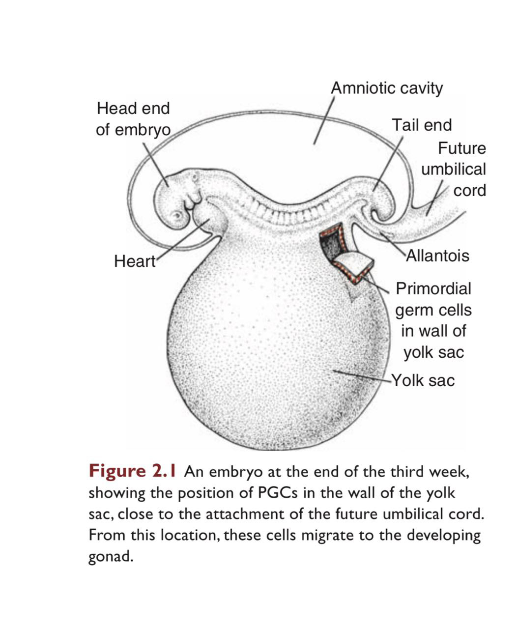
Primordial Germ Cells
During the fourth week, these cells begin to migrate from the yolk sac toward the developing gonad, where they arrive by the end of the fifth week. Mitotic divisions increase their number during their migration and also when they arrive in the gonad. In preparation for fertilization, germ cells undergo gametogenesis, which includes meiosis, to reduce the number of chromosomes and cytodifferentiation to complete their maturation

Slide 4
Mitosis
Mitosis is the process whereby one cell divides, giving rise to two daughter cells that are genetically identical to the parent cell .Each daughter cell receives the complete complement of 46 chromosomes.

Slide 5
Meiosis
Meiosis is the cell division that takes place in the germ cells to generate male and female gametes, sperm and egg cells, respectively. Meiosis requires two cell divisions, meiosis I and meiosis II, to reduce the number of chromosomes to the haploid number of 23 .

Slide 6
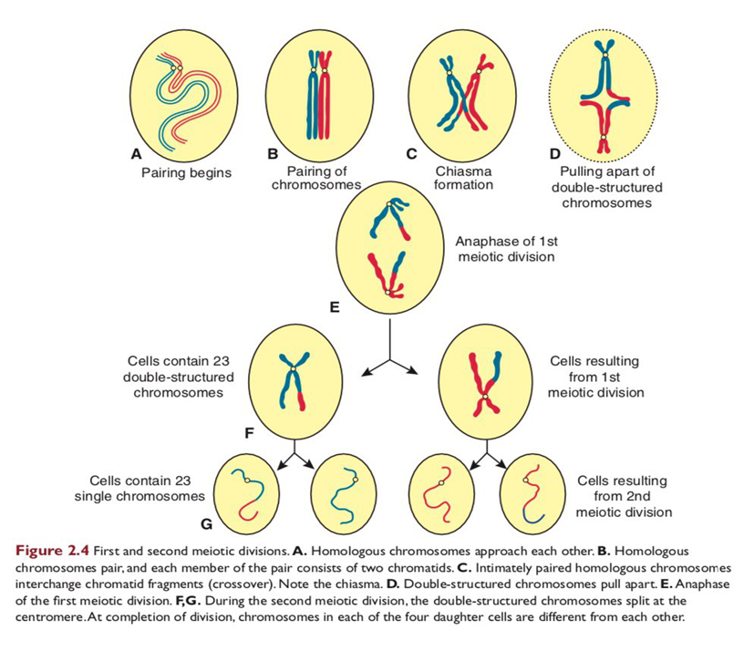
Meiosis
As in mitosis, male and female germ cells (spermatocytes and primary oocytes) at the beginning of meiosis I replicate their DNA so that each of the 46 chromosomes is duplicated into sister chromatids. In contrast to mitosis, however, homologous chromosomes then align themselves in pairs, a process called synapsis.

Slide 7
Meiosis
Homologous pairs then separate into two daughter cells, thereby reducing the chromosome number from diploid to haploid. Shortly thereafter, meiosis II separates sister chromatids. Each gamete then contains 23 chromosomes.

Slide 8
Crossover
Crossovers, critical events in meiosis I, are the interchange of chromatid segments between paired homologous chromosomes . Segments of chromatids break and are exchanged as homologous chromosomes separate.

Slide 9
Crossover
As separation occurs, points of interchange are temporarily united and form an X-like structure, a chiasma. The approximately 30 to 40 crossovers with each meiotic I division.

Slide 10
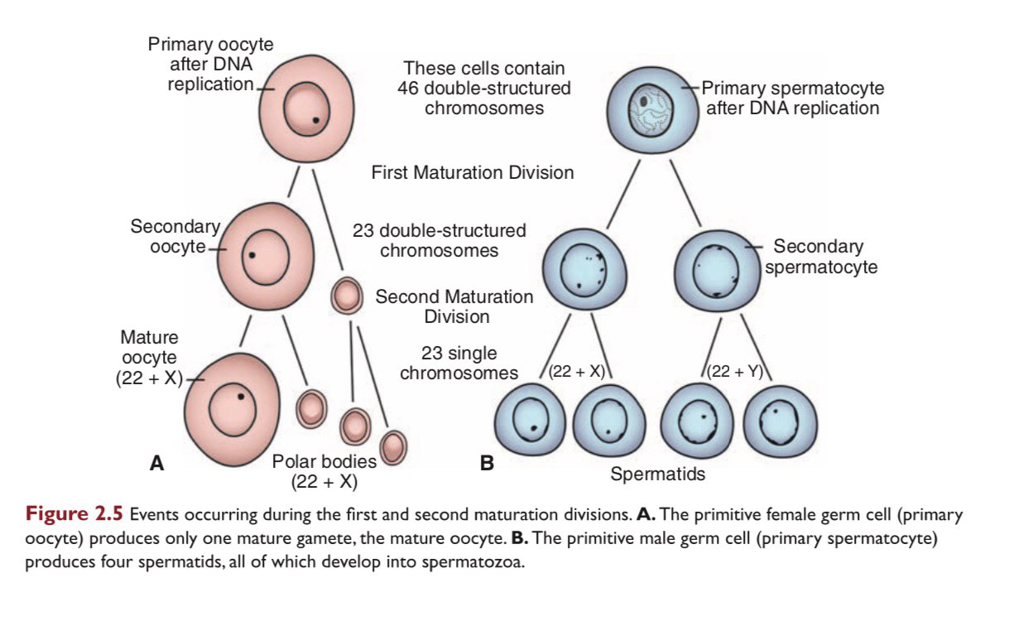
Polar Bodies
Also during meiosis, one primary oocyte gives rise to four daughter cells, each with 22 plus 1 X chromosomes. Only one of these develops into mature gamete, however, the oocyte; the other three, the polar bodies, receive little cytoplasm and degenerate during subsequent development.

Slide 11
Oogenesis
Oogenesis is the process by which female gamete produced in the ovary
Maturation of oocyte begins before birth
once PGCs have arrived in the gonads of a genetic female, they differentiate into oogonia.

Slide 12
Oogenesis
These cells undergo a number of mitotic divisions and by the end of third month, they are arranged in clusters surrounded by a layer of flat epithelial cells known as follicular cells, originate from surface epithelium covering the ovary.

Slide 13
Oogenesis
The majority of oogonia continue to divide by mitosis, but some of them arrest their cells division in prophase of meiosis I and form primary oocytes.

Slide 14
Oogenesis
A primary oocyte, together with its surrounding flat epithelia cells, is known as a primordial follicle
As primordial follicles begin to grow, surrounding follicular cells change from ﬂat to cuboidal and proliferate to produce a stratiﬁed epithelium of granulosa cells, and the unit is called a primary follicle

Slide 15
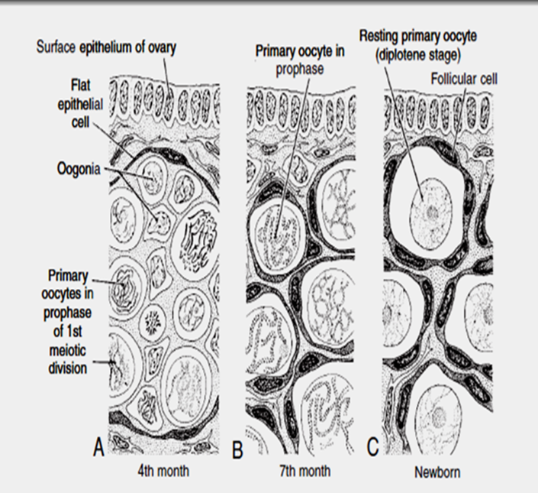
Maturation of oocytes continues at puberty
Near the time of birth, all primary oocytes have started prophase of meiosis I, but instead of proceeding into metaphase, they enter the diplotene stage, a resting stage during prophase.
This arrested state is produced by oocyte maturation inhibitor (OMI).

Slide 16
The total number of primary oocytes at birth is estimated to vary from 600,000 to 800,000. During childhood, most oocytes become atretic; only approximately 40,000 are present by the beginning of puberty, and fewer than 500 will be ovulated

Slide 17
At puberty, Each month, 15 to 20 follicles begin to mature. Some of these die, while others begin to accumulate ﬂuid in a space called the antrum, thereby entering the antral or vesicular stage. immediately prior to ovulation, follicles are quite swollen and are called mature vesicular follicles or Grafﬁan follicles .

Slide 18
The granulosa cells near the primary oocyte is called the cumulus oophorus.
Granulosa cells rest on a basement
membrane form the theca folliculi.
Also, granulosa cells and the oocyte secrete a layer of glycoproteins on the
surface of the oocyte, forming the zona pellucida As follicles continue to grow, cells of the theca folliculi organize into an inner layer of secretory cells, the theca interna, and an outer ﬁbrous capsule, the theca externa.

Slide 19
When the secondary follicle is mature, Meiosis I is completed, resulting in formation of two daughter cells of unequal size, each with 23 double-structured chromosomes . One cell, the secondary oocyte, receives most of the cytoplasm; the other, the ﬁrst polar body, receives practically none.

Slide 20
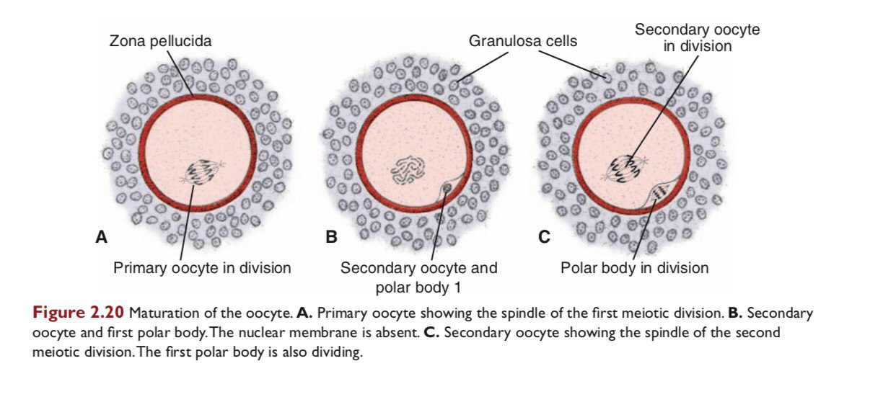
The cell then enters meiosis II but arrests in metaphase approximately 3 hours before ovulation. Meiosis II is completed only if the oocyte is fertilized; otherwise, the cell degenerates approximately 24 hours after ovulation.

